Slide 1
UniFida Consulting
Helping you build more
customer value at less marketing cost
Consulting + Technology + Data Science

Slide 2
UniFida Consulting Helping unlock the value from your customers
The kinds of questions we help our clients to answer
How best to allocate your marketing budget across recruitment channels and media
How to plan a customer communications strategy over time to deliver the best ROI
How to use personalisation that works for websites and emails
How to get the decision support you need to plan
And many more!

Slide 3
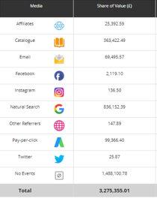
UniFida Consulting Developing a recruitment strategy
We help you answer questions like:
What is the true contribution of each channel in combination with others to building your customer base?
What types of customer come from which source?
Which customer recruits evolve into longer term value providers?
So that you can best allocate your recruitment budget across channels and media

Slide 4
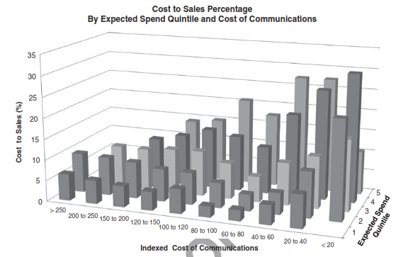
UniFida Consulting Building a customer contact strategy
Evaluating how your current customer contact strategy is performing
Planning how to invest the right amount in communicating to each individual customer
Predicting which proposition each customer is most likely to respond to
Knowing which customers are at risk of attrition and introducing save strategies
Accurately attributing results to campaigns
Undertaking and evaluating testing

Slide 5
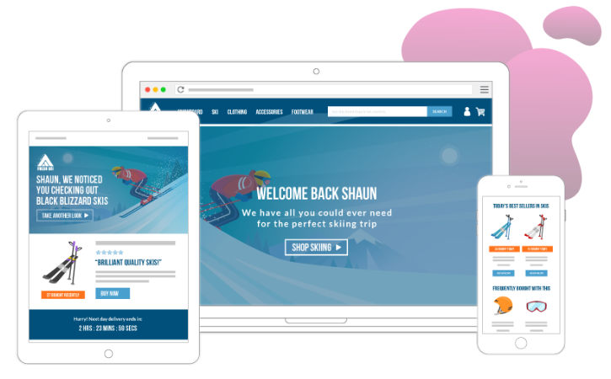
UniFida Consulting How to use personalisation for websites and emails?
Personalisation can come in many flavours
We work with Fresh Relevance for the technology that delivers it
They advise on you on how best to get advantage from their toolkit
We support you with understanding how to use customer triggers, customer life-stage and customer value to pitch to your customers
And in undertaking continuous experimentation

Slide 6
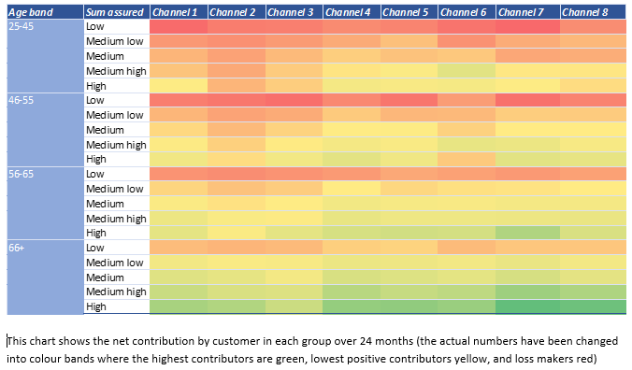
UniFida Consulting Getting the decision support you need to plan
We all believe in data driven decision making; the issue is what questions to ask, and how to get the data analysed?
The market is awash with tools, but can look like a desert when it comes to data scientists
We help clients articulate their hypotheses, and then provide the data science resources to deliver the answers
We see marketing as a continuous value chain from spending in recruitment, to managing customer retention
At each stage we can help you optimise how money is best spent to get the most customer value

Slide 7
UniFida Consulting
Helping you build more
customer value at less marketing cost
Consulting + Technology + Data Science

